Slide 1
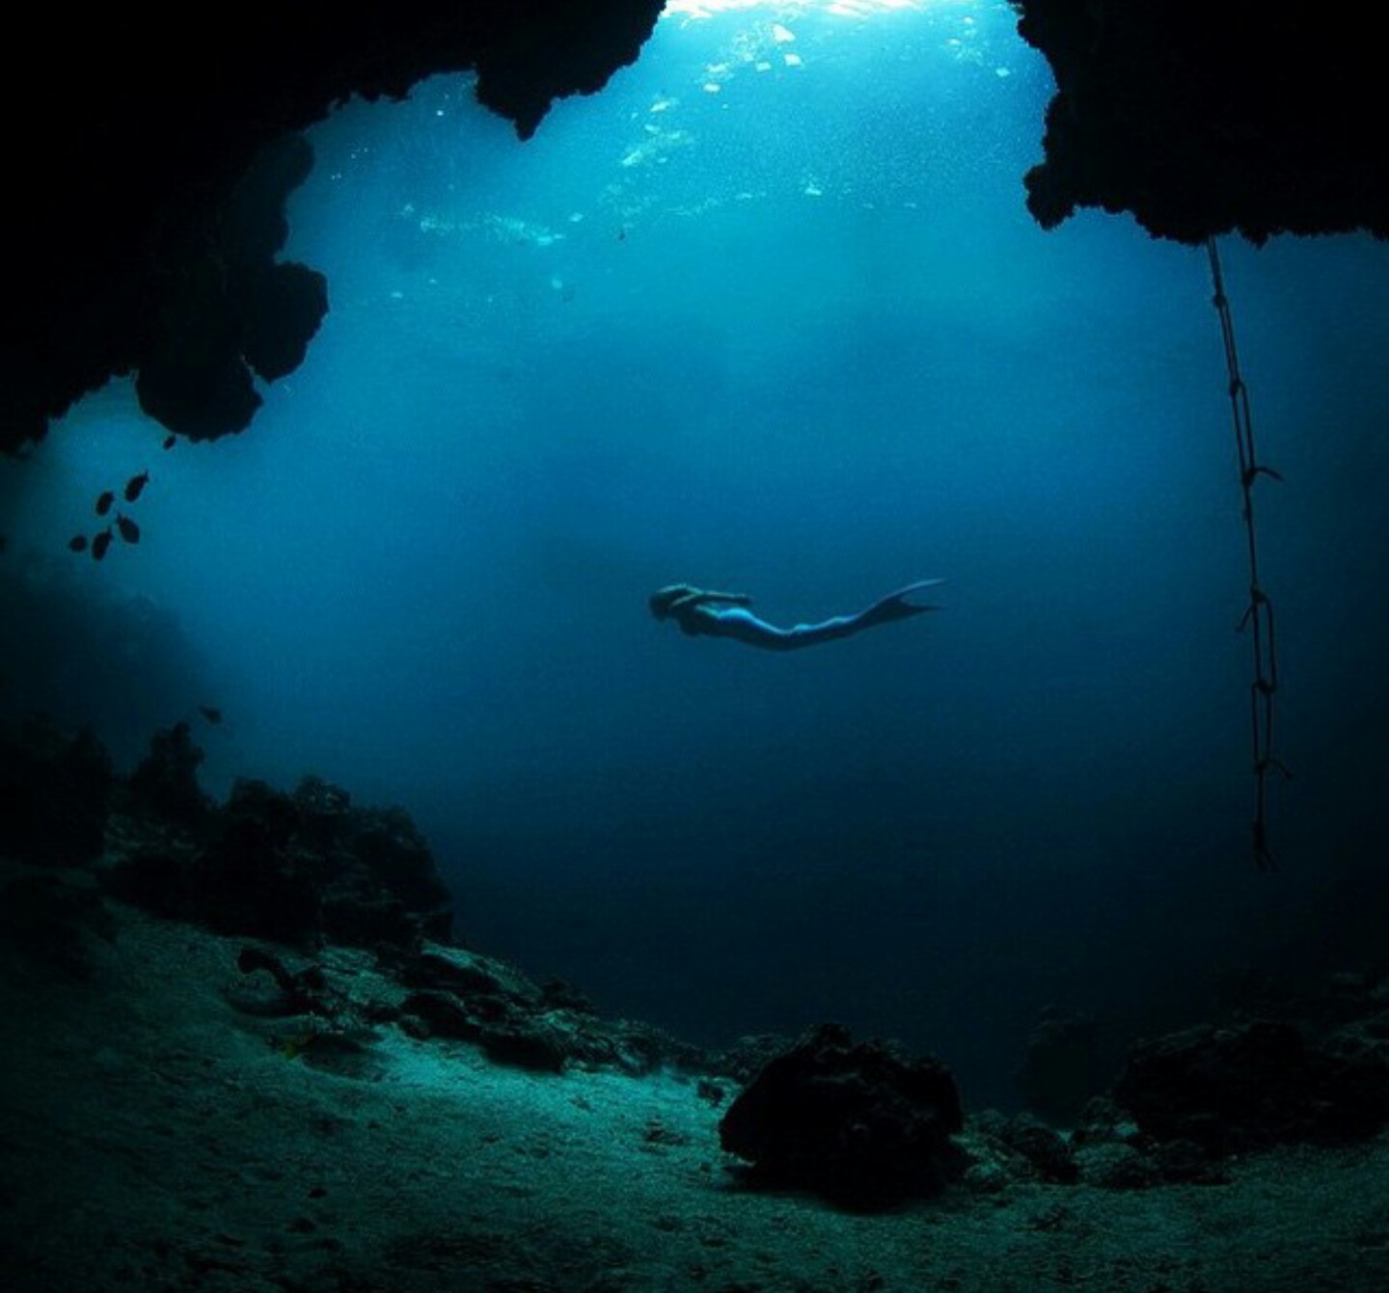
Mermaid’s Tears
A Game by Samantha-Jade Kennedy
VGTG Class 10/26/2018

Slide 2
Walkthrough
-Story-
-Gameplay & General Info-
-Objectives-
-Development Requirements and Timeline-
-Summary-

Slide 3
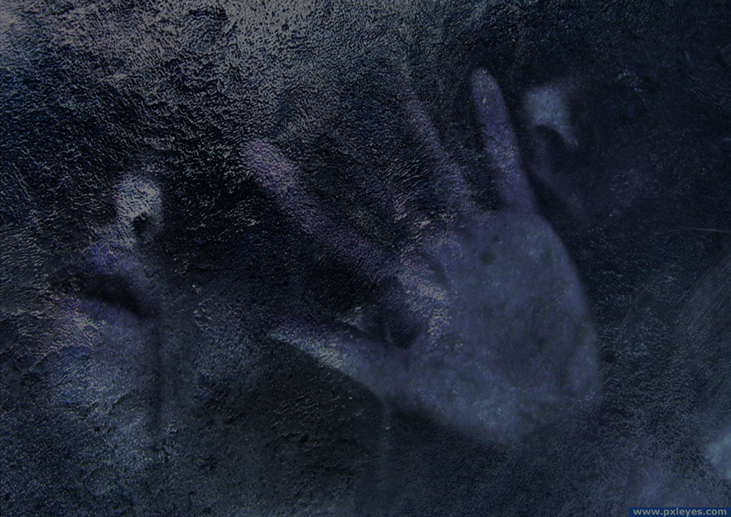
-Story-
You are a noble merperson, a friend to the heir.
One day as you are heading out to see them, you are overtaken by a wave of cold and darkness. Suddenly the whole palace is covered in dark ice.

Slide 4
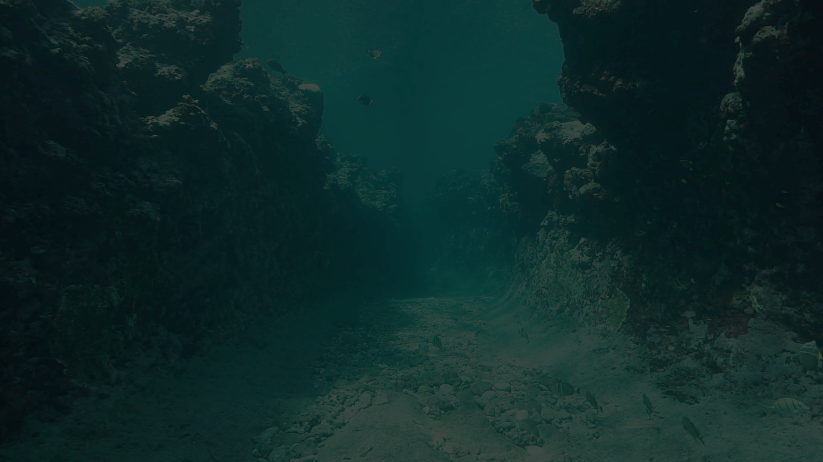
Only you can save your friends and family.
Will you dare the long and dangerous journey through the deep?

Slide 5
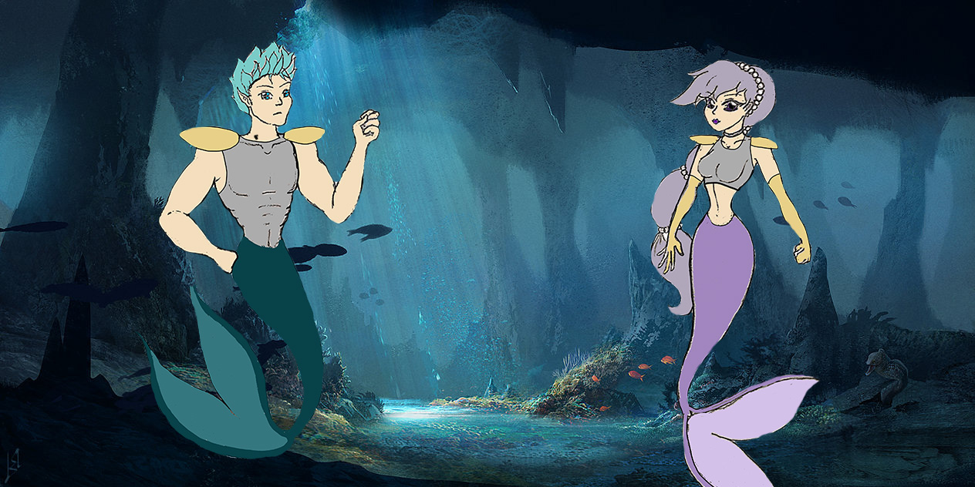
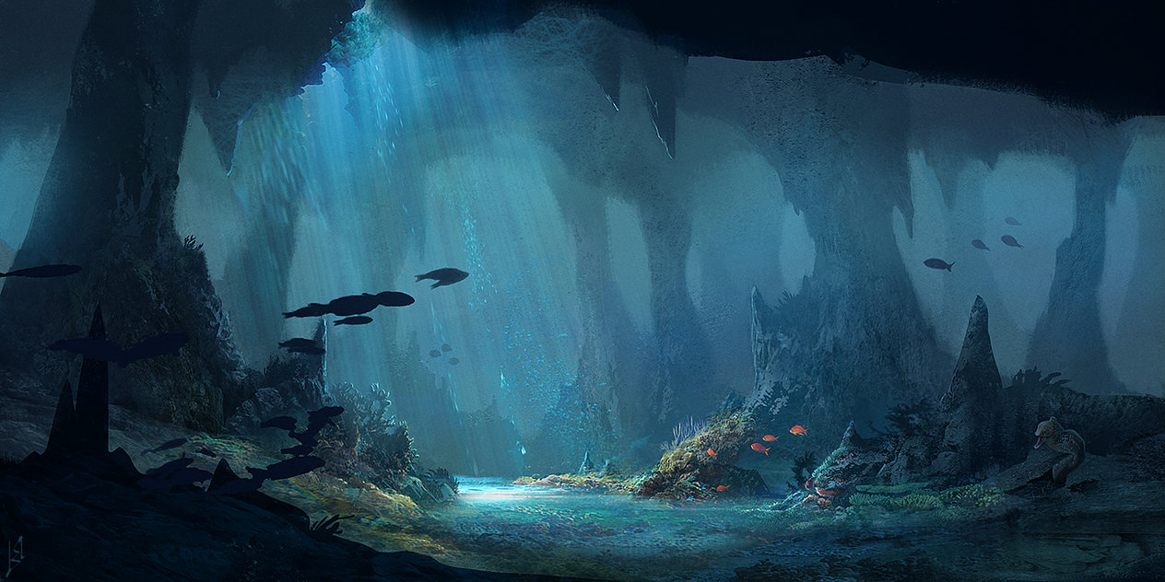
-Conceptual Art-

Slide 6
Gameplay & General Info
This game is an RPG designed for PC or Console
Intended Rating is Teen as there are battles and some blood
Choose your first weapon
Sword (mele), Trident (magic) or Spear (ranged)
Collect other weapons an Items throughout the game
Can you master them all?

Slide 7

Explore a stunning 3D world where you can move in all directions, not just along the ground.
Find collectables and open treasure chests to reveal helpful Items
Battle creatures of darkness.
Fight to save creatures that will help you along the way

Slide 8

Objectives
Save the Kingdom!
Defeat the terrible Sea monster
Collect Items to complete collections and earn special rewards
Learn new skills and acquire legendary Items
Choose to Marry the heir or Conquer the Kingdom
Learn to walk on land and continue exploring.

Slide 9
-Development Requirements and Timeline-
Due to the vast breadth of this game, development is expected to take 2-3 years, With approx. 300 developers
(Based on games of similar size and complexity such as Zelda , breath of the wild)

Slide 10
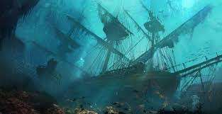
-In Summary-
In summary this game is meant to be an epic adventure RPG with a huge environment to explore
A number of planned DLCs will help extend the overall life of the game.

Slide 11
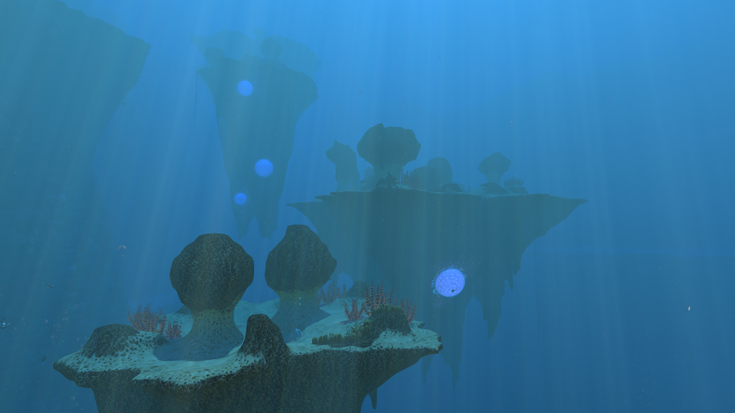
-Q&A-

Slide 12
-Thank You-

